Slide 1
ODA Noxious Weed Program
Program & Listing Updates
Benton CWMA
Troy Abercrombie- Program Manager

Slide 2
What we’ve been up to...
List Changes & Rulemaking
Natural and Working Lands Initiatives continue
Rangeland Health & Resilience
Oregon Native Seed Strategy
Wildfire Recovery
Staffing
OSWB Grants
Risk Assessments
Symposium in 2026 (+ Native Plant Symposium)

Slide 3
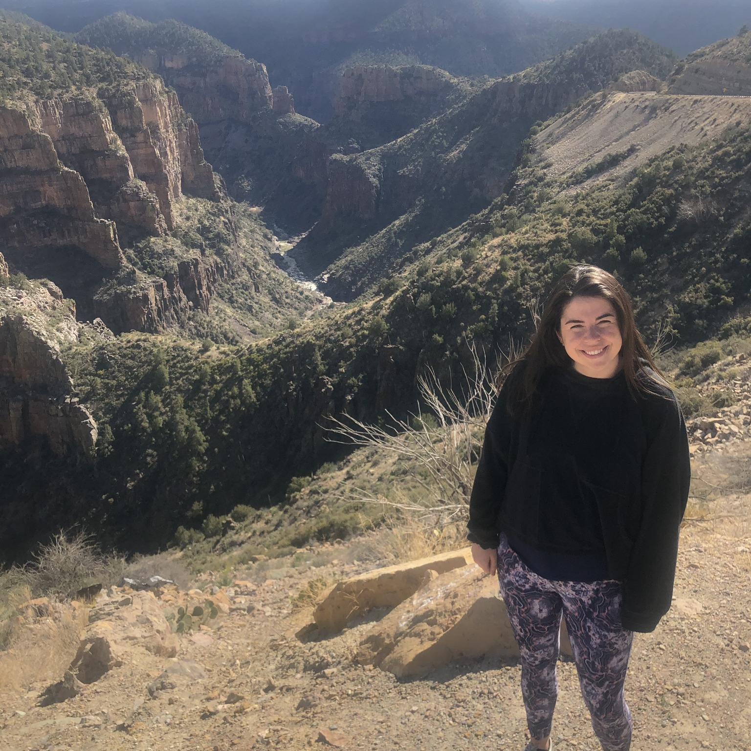
New Staff: Ashley Toland
ODA Biocontrol Entomologist
Hired late 2025
Extensive insect biocontrol experience
Looking to connect!

Slide 4
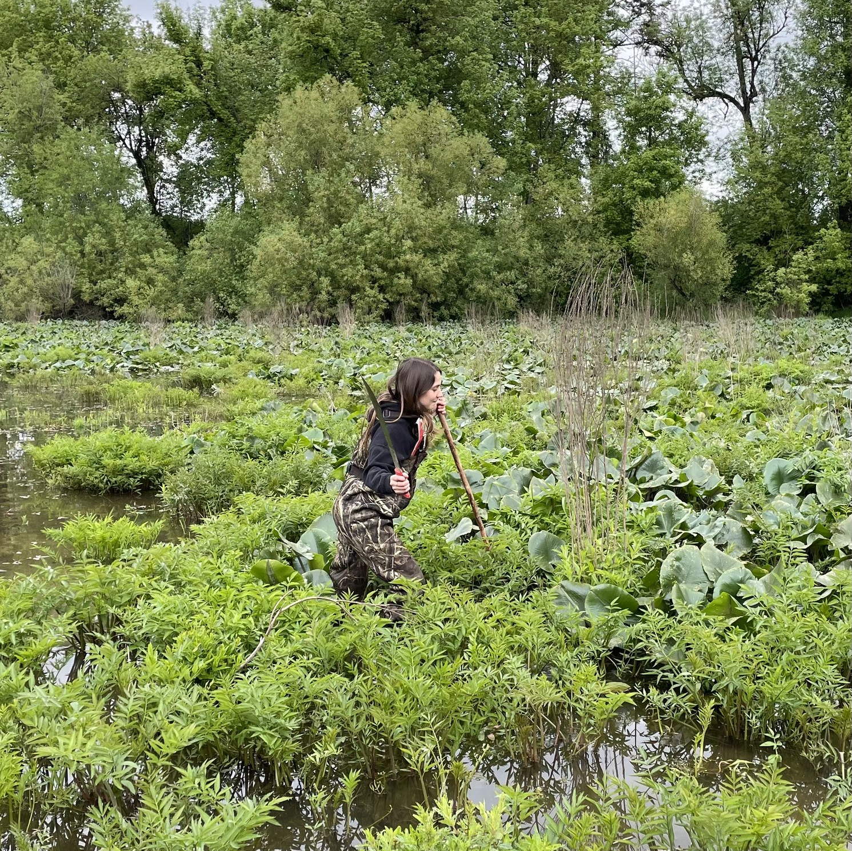
New Staff: Jordan Donaghy
ODA Biocontrol Technician
Converted to permanent status in 2026
Greenhouse extraordinaire
Field technician

Slide 5
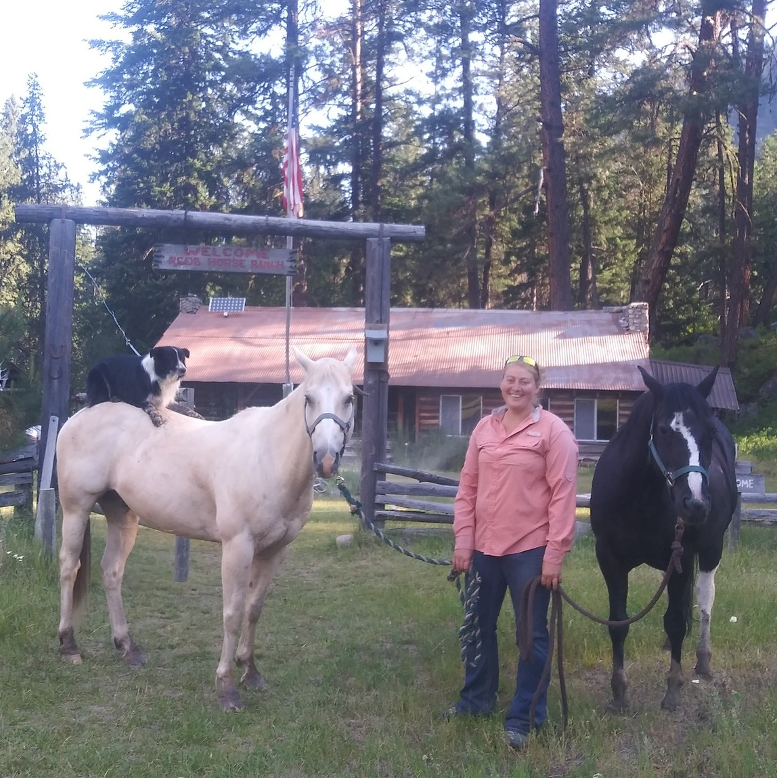
New Staff: Shanda Hyllested
NE Oregon Weeds Specialist
Replaces Mark Porter
Former Director of Tri-County CWMA
Perfect fit for our program in that region
Already making impacts to program

Slide 6
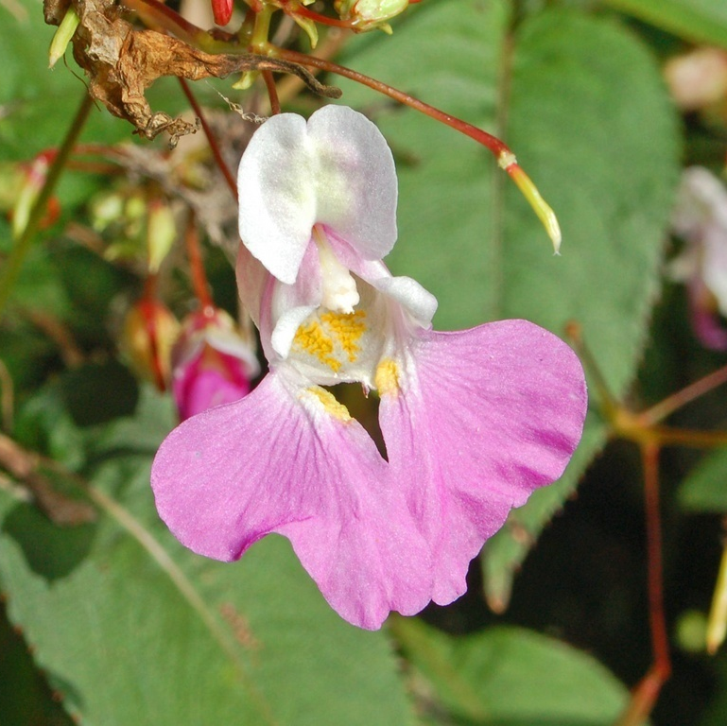
Risk Assessments & Listings
October 2025 OSWB Meeting
Oriental Bittersweet
Stinkwort
Both listed as A-rated
Yellow Bush Lupine
Listed as B-rated
February 2026 OSWB Meeting
Impatiens balfouri
Sessilfruited Arrowhead
RA but no listing
Watch List
Waterhemp
A-rated with conditions

Slide 7
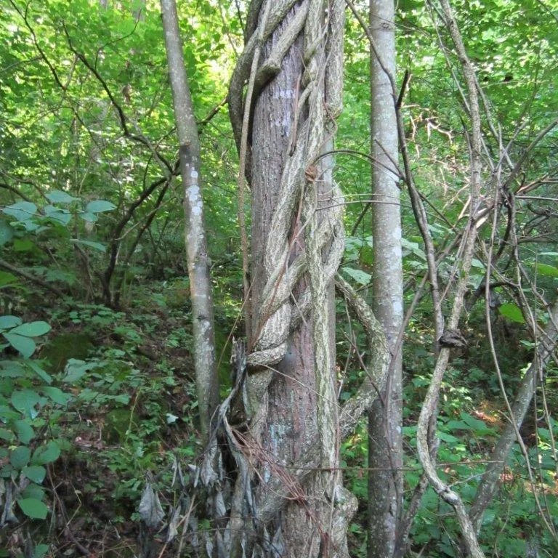
Oriental Bittersweet
Celastrus orbiculatus
Native to Eastern Asia
Woody vine that climbs trees
Already troublesome in Northeast US
Single site in Clackamas County

Slide 8
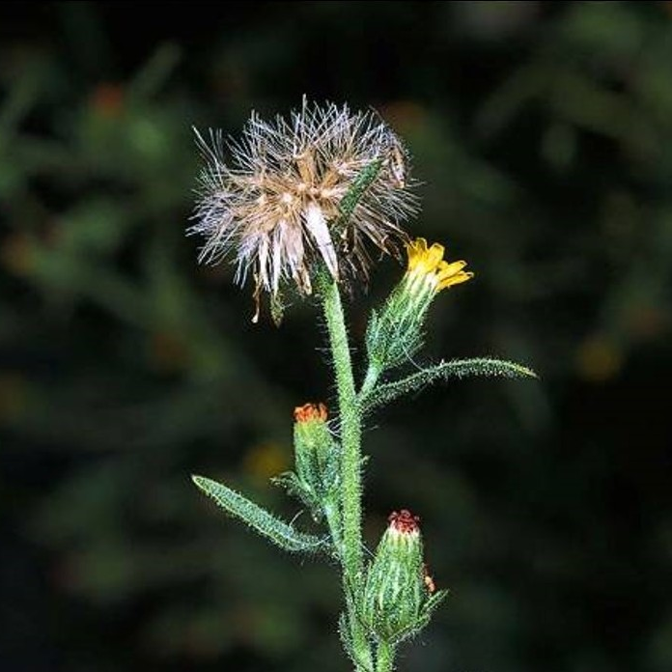
Stinkwort
Dittrichia graveolens
Annual aster
Rapidly established in California in 1980’s
No forage value, extremely competitive
Single plant found in S. Oregon

Slide 9
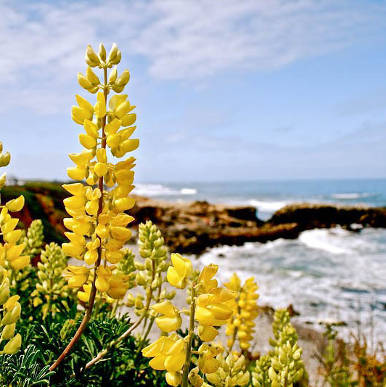
Yellow Bush Lupine
Lupinus arboreus
Woody perennial
Thrives in coastal habitats
Native to CA, becoming invasive
Found along Oregon coast, up to at least to Tillamook Co.
Catalyst for conversations about listing US natives

Slide 10
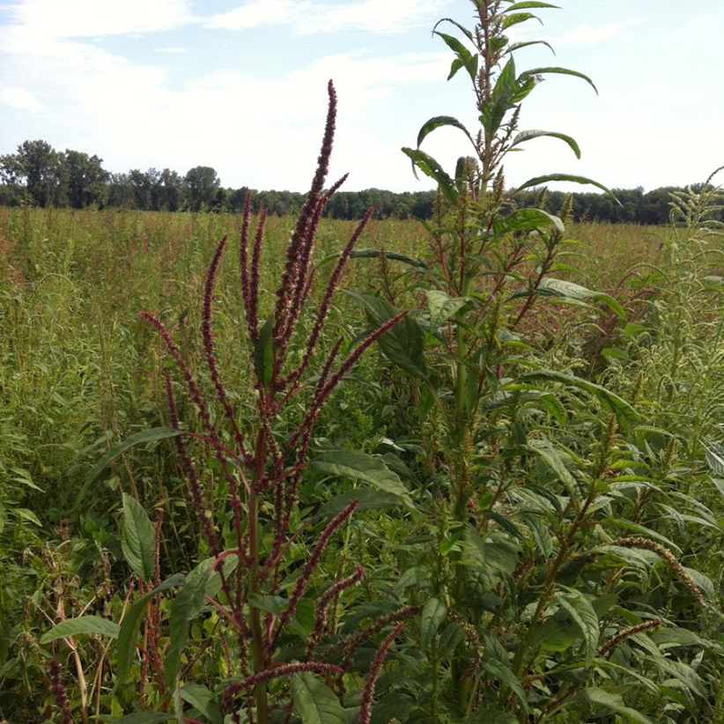
Waterhemp
Amaranthus tuberculatus
Nearly analogous to Palmer
Resistant to 6+ herbicide groups
Extensive populations in Idaho
Minimal presence in Oregon*
Notes:
Group 2 (ALS Inhibitors): E.g., Classic, Raptor. Group 3 (Dinitroanilines/Microtubule Inhibitors): E.g., Prowl. Group 4 (Synthetic Auxins): E.g., 2,4-D, Dicamba. Group 5/6 (Photosystem II Inhibitors): E.g., Atrazine, Bromoxynil. Group 9 (Glyphosate/EPSPS Inhibitors): Roundup. Group 10 (Glufosinate): Resistance is rare but reported. Group 14 (PPO Inhibitors): E.g., Flexstar, Cobra, Valor, Group 15 (VLCFA Inhibitors): E.g., Dual Magnum. Group 27 (HPPD Inhibitors): E.g., Callisto, Laudis, Impact.

Slide 11
Questions? Troy Abercrombie troy.abercrombie@oda.oregon.gov (503) 983-4065

